Slide 1
Recap 1st Midterm

Slide 2
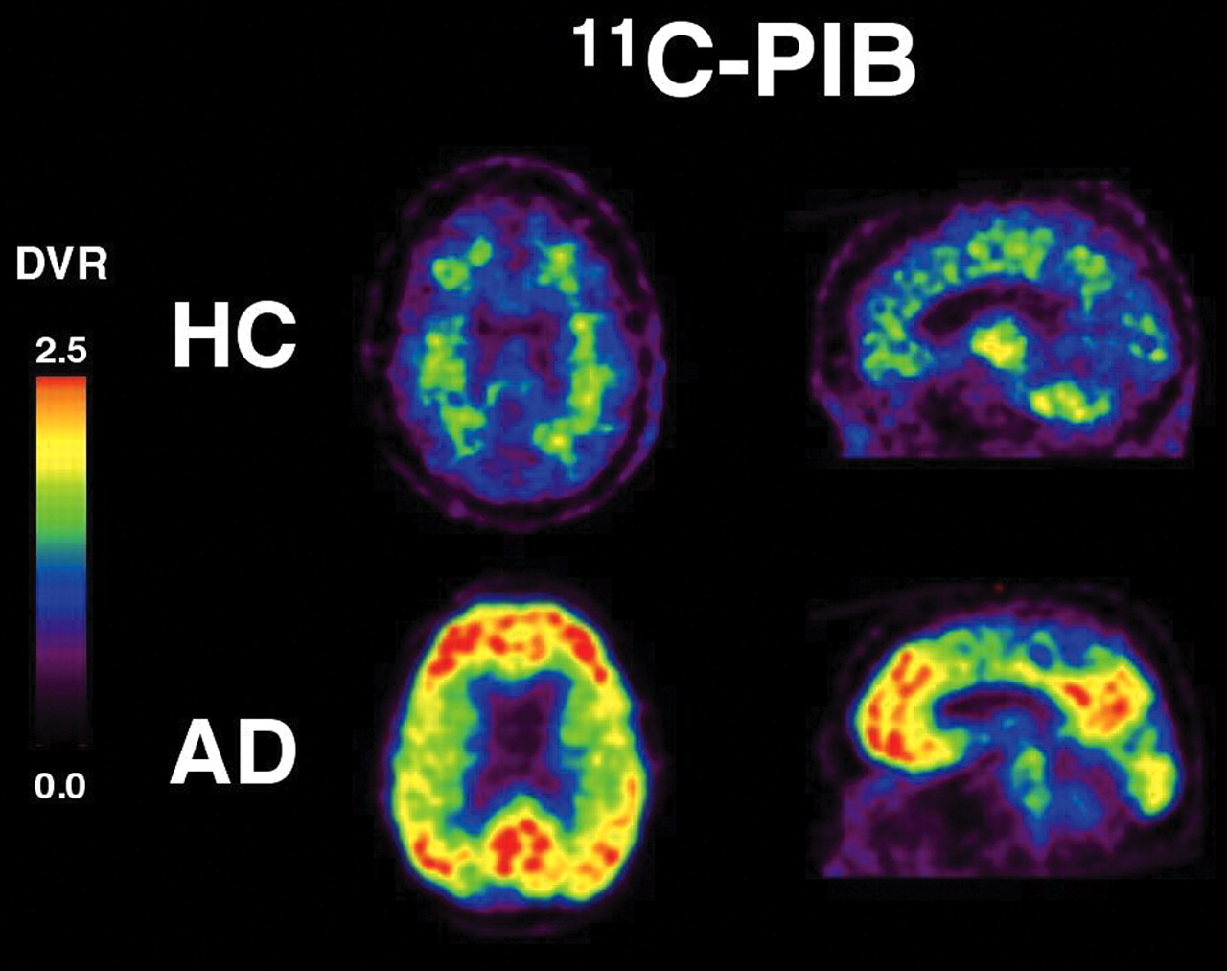
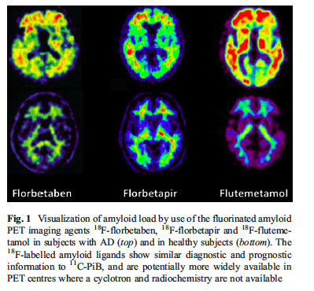
Amyloid-binding molecules are used in PET to follow the progression of amyloid deposition in AD
AD
HC

Slide 3
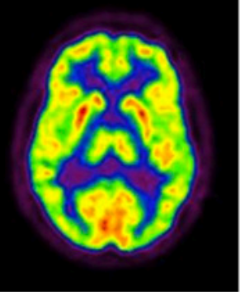
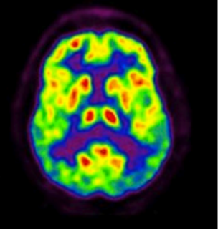
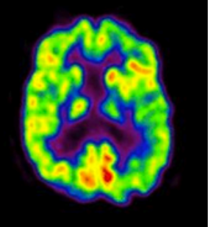
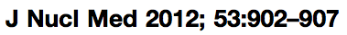
Uptake or radioactive FDG (fluorodeoxyglucose) to trace Metabolically Active Neurons (LIVING neurons)
Applications for diagnosis of AD
HC
AD
Possible AD

Slide 4
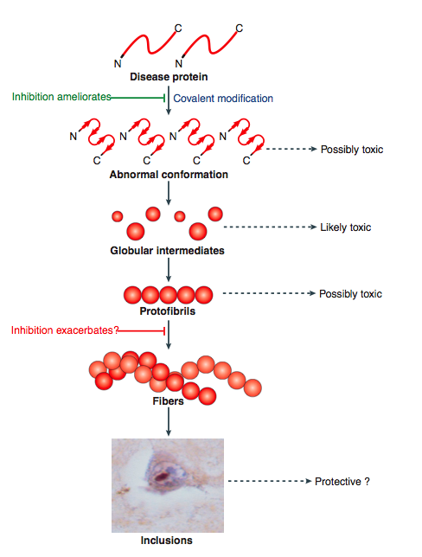
How proteins aggregate and form amyloid/insoluble fibrils
Several factors may induce
protein aggregation:
1-Protein oxidation (α-synuclein in PD)
2-Metal chelation (Prion disease and AD)
3-Specific protein cleavage (AD)
4-Inefficient protein degradation of
β-sheet proteins/proteasome impairment
(PD, AD, ALS, Prion Disease, HD)
5-Change in intracellular pH (AD)
Early
Late
Ross CA, Poirier MA. Nat Med. 2004 Jul;10 Suppl:S10-7. Review.

Slide 5
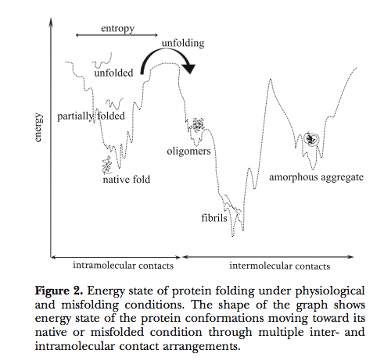
Protein Folding as a way to stabilize proteins: the Folding Funnel
Thermodynamics of protein folding/misfolding
“The energy of the different conformations decreases with the development of organized, native-like proteins”.

Slide 6
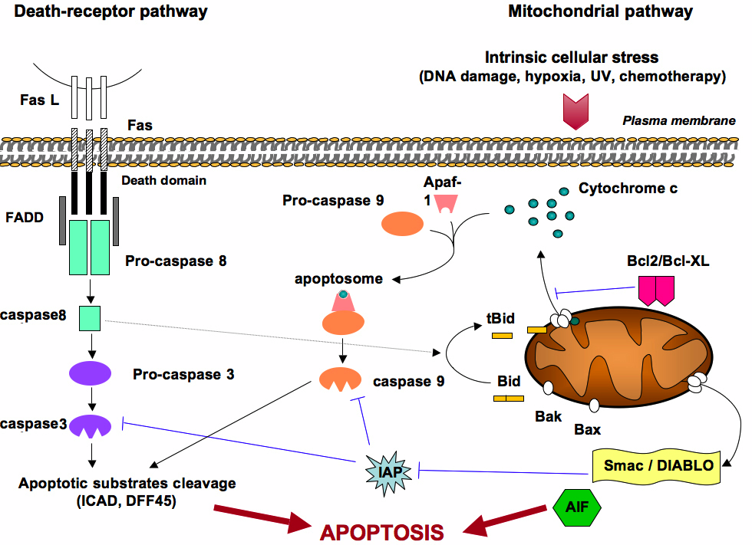
Apoptotic Pathways
http://www.bioscience.org/
Mitochondrial apoptotic pathway. Death can be induced by the binding of ligands (such as FasL) to specific receptors (such as FAS) located at the cell surface. FAS contains a cytoplasmic death domain where FADD (Fas-associated death domain) can bind in presence of FasL, and recruit Pro-caspase 8 for subsequent activation in caspase 8. This induces caspase 3 activation. Caspase 3 cleaves I-CAD, the inhibitor of CAD (Caspase-activated DNase), which is released to enter the nucleus and cleaves DNA. In addition caspase 8 cleaves Bid protein, resulting in a truncated Bid (tBid) that, upon dimerisation of Bax or Bad, causes the release of cytochrome c from mitochondria. The mechanisms by which Bax leads to mitochondrial membrane permeabilisation and subsequent release of pro-apoptotic factors still remain unclear. It is proposed that Bax could interact with the permeability transition pore, or form channels by self-oligomerization. This leads to the mitochondrial release of cytochrome c and Smac/Diablo (Smac: second mitochondrial- derived activator of caspase; Diablo: direct IAP-binding protein with low pI), AIF (apoptosis inducing factor) and various procaspases. Bcl2 inhibits the release of cytochrome C and AIF in the cytoplasm and prevents the variation of the permeability transition pore. In the cytosol, cytochrome c binds to Apaf-1 (apoptosis- protease- activating factor). Both proteins form the apoptosome, which converts procaspase 9 in caspase 9. This results in activation of downstream effector caspases. Smac/DIABLO binds to IAP (Inhibitors of apoptosis) and prevent them from inhibition of the caspase 9 and caspase 3 activation. AIF has an indirect role in chromosome degradation as it activates endonuclease G, a DNase that moves from the mitochondria to the nucleus during apoptosis. Interestingly to note, the mtDNA is not fragmented during apoptosis.

Slide 7
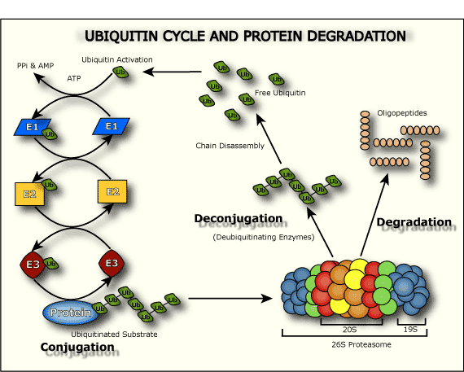
The Ubiquitin Proteasome Pathway

Slide 8
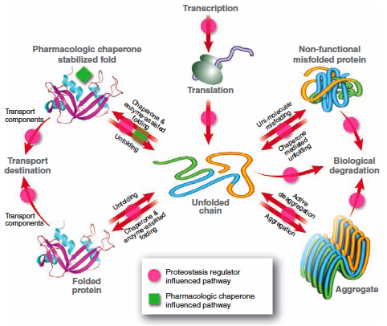
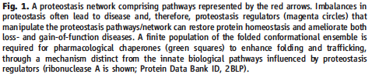
Proteostasis: Protein Homeostasis

Slide 9
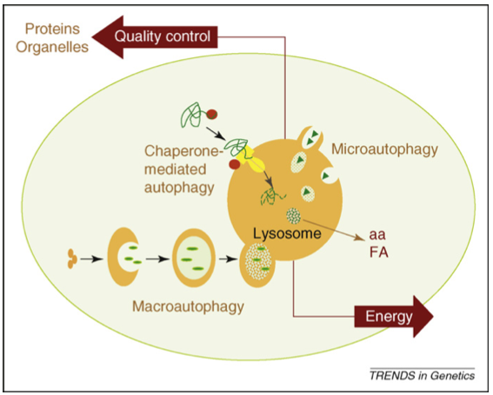
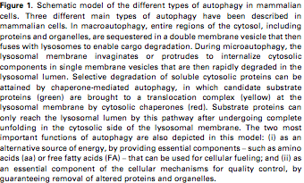
Autophagy: a method to control the degradation of
proteins, organelles, structure and aggregates
through the lysosomal pathway

Slide 10
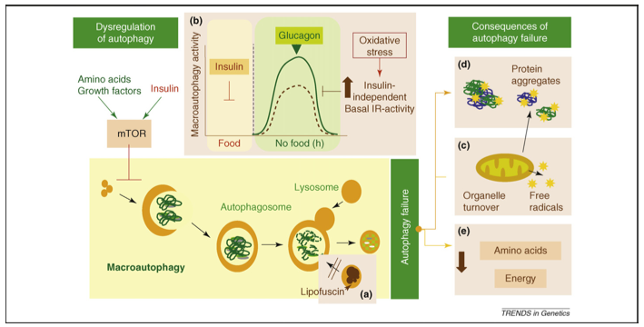
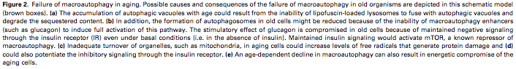
Consequences of Macroautophagy failure during aging

Slide 11
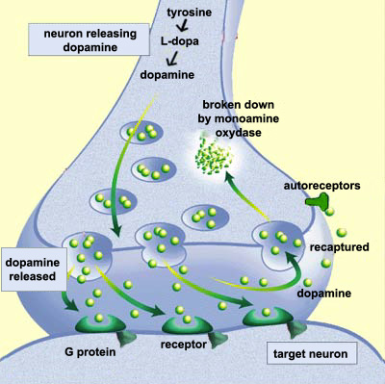
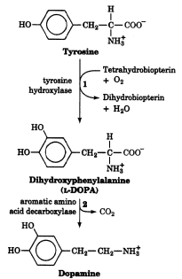
Dopamine synthesis and signaling

Slide 12
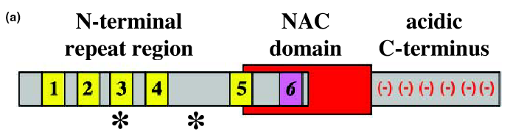
α-synuclein
A30T
A53P
A30P
A53T
In the N-terminal region there are 5-6 imperfect repeats (EKTKEGV). This region acquires α-helical secondary structure upon binding to membrane lipids, whereas the C-terminal region is highly flexible (Eliezer, 2001).
NAC=non amyloid component, in this hydrophobic region are aa crucial for α-synuclein aggregation.
Kahle et al.,

Slide 13
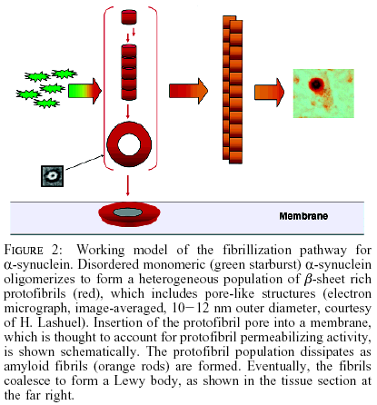
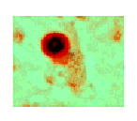
Model of α-synuclein fibrillization
Volles and Lansbury

Slide 14
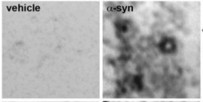
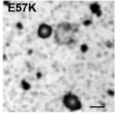
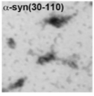
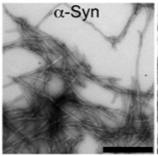
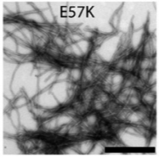
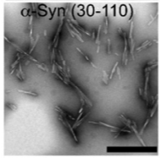
Fibrillar alpha-synuclein forms pore-like structures
E35
E57

Slide 15
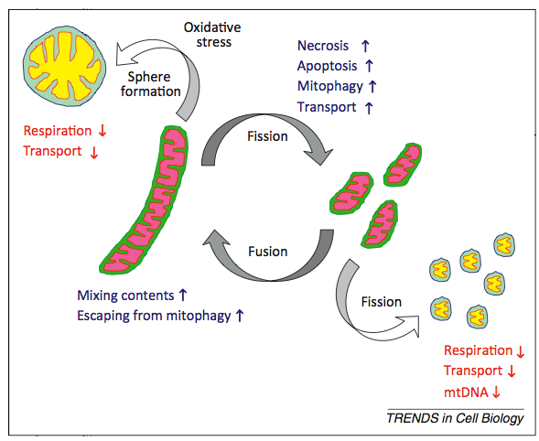
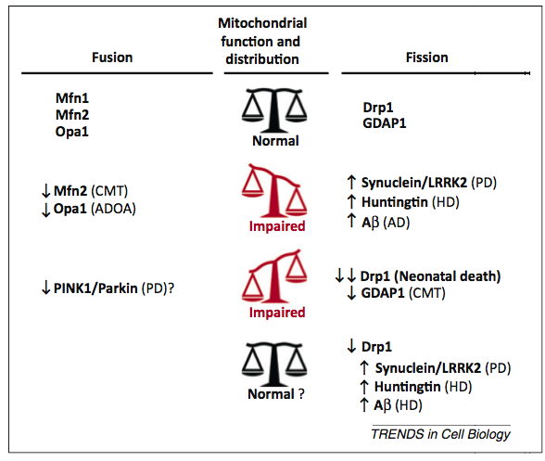
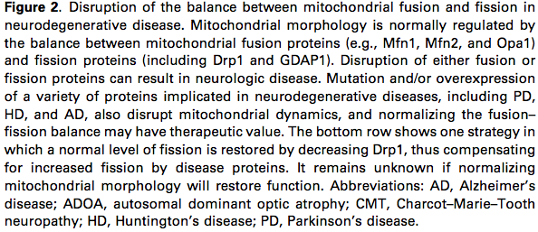
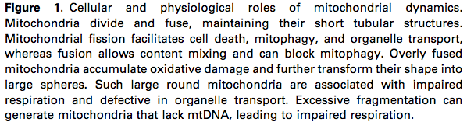
Mitochondrial dynamics in neurodegeneration
Physiologic Fission and Fusion
Balance or disease
Itoh et al., Trends in Cell Biology 2012

Slide 16
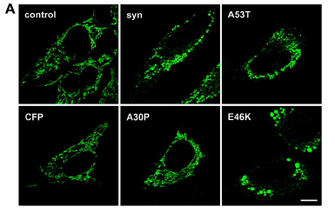
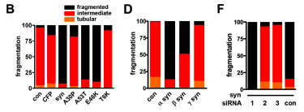
Overexpression of α-syn induces mitochondrial fragmentation

Slide 17
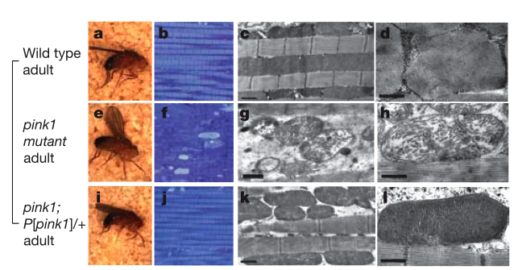
Muscle degeneration and mitochondrial cristae fragmentation are observed in adult PINK1 mutant flies
Rescue of the phenotype with PINK1 re-expression
Clark et al., 2006

Slide 18
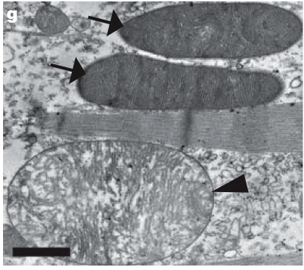
Parkin, like PINK1 re-expression, rescues the mitochondrial structure and cristae fragmentation
Parkin overexpression
Clark et al., 2006

Slide 19
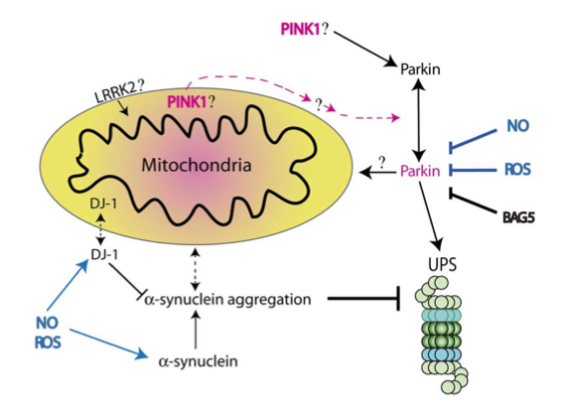
Parkin acts DOWNSTREAM of PINK1

Slide 20
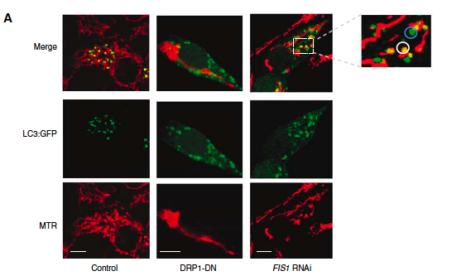
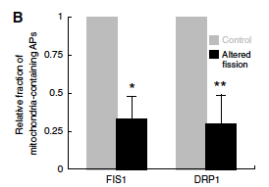
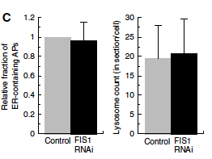
Fission increases disposal of mitochondria
via autophagic mechanisms

Slide 21
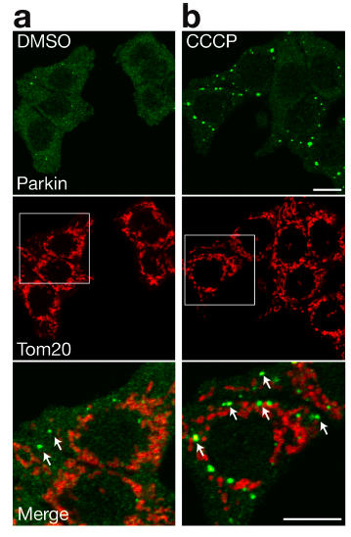
Depolarization recruits parkin to the outer mitochondrial membrane

Slide 22
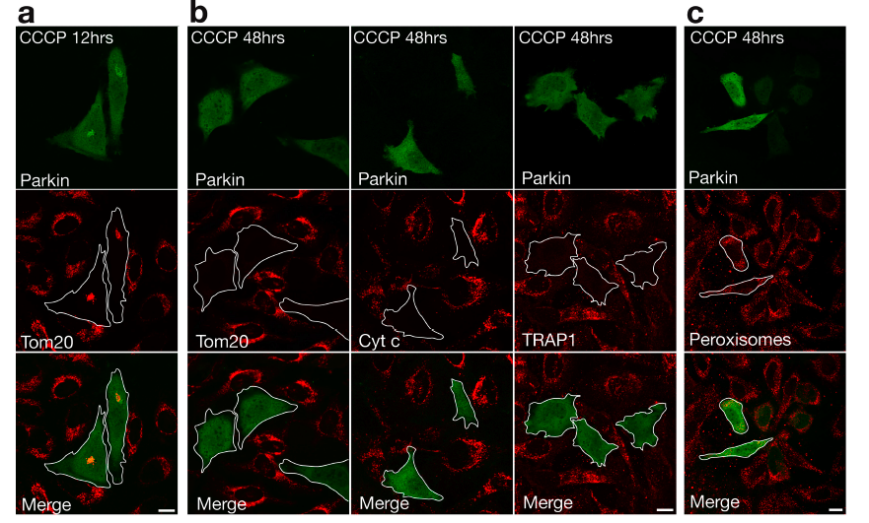
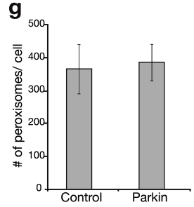
Depolarization induces parkin-mediated clearance
specifically of mitochondria

Slide 23
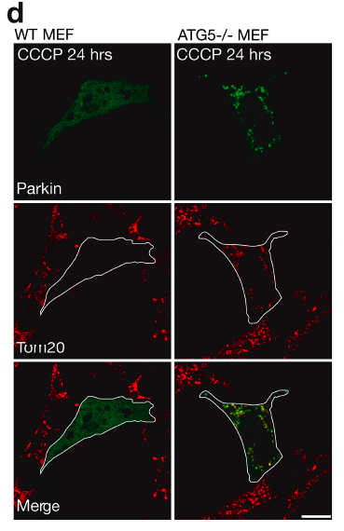
Parkin-mediated clearance of mitochondria occurs
via autophagic mechanisms

Slide 24
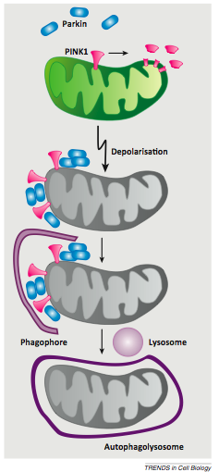
PINK1 and Parkin regulate Mitophagy

Slide 25
PINK1 and ΔΨm recruit parkin to the outer mitochondrial membrane
to begin mitophagy
M E C H A N I S M ?

